Slide 1

Advanced x86: BIOS and System Management Mode Internals PCI
Xeno Kovah && Corey Kallenberg
LegbaCore, LLC

Slide 2
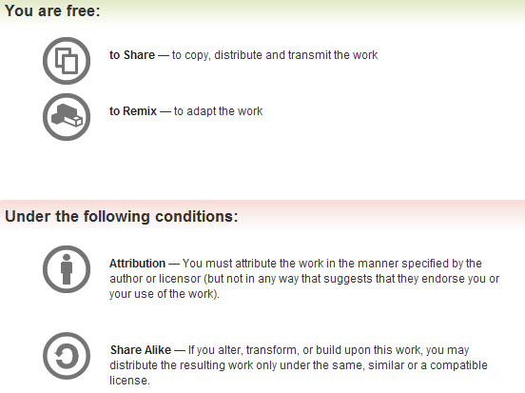
All materials are licensed under a Creative Commons “Share Alike” license.
http://creativecommons.org/licenses/by-sa/3.0/
Attribution condition: You must indicate that derivative work
"Is derived from John Butterworth & Xeno Kovah’s ’Advanced Intel x86: BIOS and SMM’ class posted at http://opensecuritytraining.info/IntroBIOS.html”
Notes:
Attribution condition: You must indicate that derivative work
"Is derived from John Butterworth & Xeno Kovah’s ’Advanced Intel x86: BIOS and SMM’ class posted at http://opensecuritytraining.info/IntroBIOS.html”

Slide 3
PCI (and PCI Express)
All your base. base. base…
all your base address registers are belong to PCI

Slide 4
PCI note:
We’re not really going to care about low level PCI protocol details
We’re just going to care about the way that it’s exposed to the BIOS, so that we can understand the BIOS’s view of the world, and therefore interpret its actions accordingly
If you care about the physical level details, you need to go out and get a big ol’ book (like the full version of this https://www.mindshare.com/files/ebooks/PCI%20Express%20System%20Architecture.pdf)

Slide 5
PCI
Peripheral Component Interconnect (PCI)
Also called Compatible PCI
It’s a bus protocol developed by Intel around 1993
Purpose is to attach/interconnect local hardware devices to a computer
PCI is integrated into the chipset, forming a “backbone”
Holds true for both Intel and AMD-based systems
Logically speaking, the Chipset is a PCI System
32-bit bus with multiplexed address and data lines
Supports 64-bit by performing two 32-bit reads
PCI component interface is processor independent
The CPU/BIOS reads and writes to the configuration space to configure much of the system
Intel’s MCH/ICH chipsets implement PCI Local Bus Protocol 2.3
PCH chipsets implement PCI Express protocol (v. 2.0)
Still supports PCI 2.3
PCI standards are currently maintained and defined by the PCI /SIG:
http://www.pcisig.com/specifications/
Notes:
First we’ll talk about Compatible PCI, then we’ll cover PCI Express afterwards. Once you know PCI, PCI Express is just a logical extension with a few key differences.
You can call them “PCI systems” and not really be wrong to do so, at least logically. Although a hardware guy might get mad but will concede your point if you specify logically.

Slide 6
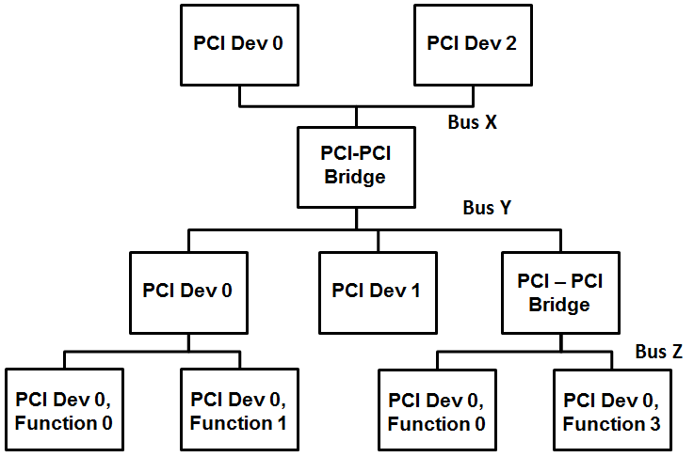
Generic PCI Topology: Buses, Devices, and Functions
Up to 256 Buses
Each Bus can have up to 32 devices attached
Each Device can extend up to 8 Functions
Buses are interconnected by Bridges
Multiple bridges can be connected through a bridge interface and are enumerated

Slide 7
PCI Address Spaces
PCI implements three address spaces:
1) PCI Configuration Space (up to 256 Bytes)
Required/standard. Defined in the specifications. Every PCI device has a configuration space.
2) PCI Memory-mapped space
Optional. Dependent on whether the device manufacturer needs to map system memory to the PCI device
3) PCI I/O-mapped space
Optional. Same as PCI Memory Space
Notes:
Ok so now the good stuff. How does the software block diagram help us out?

Slide 8

PCI Express (PCIe)
Peripheral Component Interconnect Express (PCIe)
Developed around 2004 (not just by Intel but a collective)
Packet-based transaction protocol
Very different from PCI at the hardware level
For software configuration purposes, it is mostly the same
Adds an extended configuration space of 4KB
Provides backwards compatibility for Compatible PCI
Adds 4KB of PCI Express Extended Capabilities registers
Located in either the Configuration space starting at offset 256 (immediately following the Compatible PCI configuration space)
Or located at a MMIO location specified in the Root Complex Register Block (RCRB)

Slide 9
PCI Express (PCIe) Address Spaces
PCIe implements four address spaces:
1) PCIe Configuration Space (up to 4KBytes)
Required/standard. Defined in the specifications. Every PCIe device has its configuration space mapped to memory.
Also provides the first 256 bytes of compatible PCI (memory-mapped and via port IO for backwards compatibility)
2) PCIe Memory-mapped space
Optional. Dependent on whether the device manufacturer needs to map system memory to the PCI device
3) PCIe I/O-mapped space
Optional. Same as PCI Memory Space
4) PCIe Message Space
For low-level protocol messaging/interrupts. We don’t get into this in this class
Notes:
Ok so now the good stuff. How does the software block diagram help us out?

Slide 10
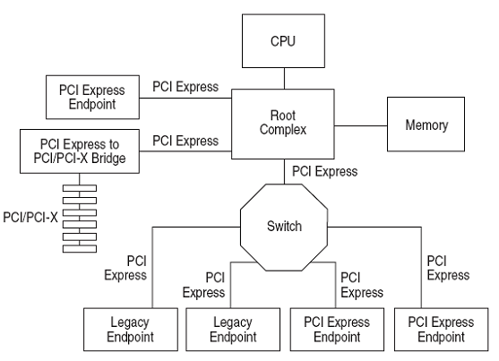

Generic PCIe Topology:
The Root Complex connects the processor to the system memory and components
Same number of devices supported as PCI
Up to 256 PCIe buses
Up to 32 PCIe devices
Up to 8 Functions
Each Function can implement up to 4 KB of configuration space
BRIDGE?! SWITCH?!
IT’S A NETWORK!
A NETWORK I TELL YOU!

Slide 11
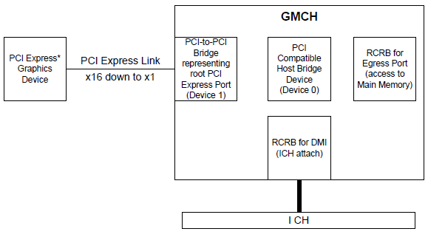
Mobile 4-Series Chipset PCIe Topology
Root Complex
Mobile 4-Series Chipset datasheet
Example:
The GMCH on the 4-Series Chipset is part of a Root Complex that connects the CPU to the graphics devices and the IO Controller Hub
Contains 2 RCRBs (Root Complex Register Blocks)
Device configuration space, each is 4 KB, similar to extended configuration space
Cheers!

Slide 12
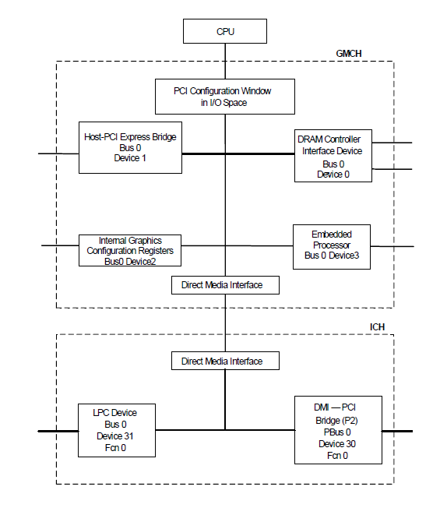
Intra-System PCIe Bus
Chipset logical Bus 0 is highlighted
Direct Media Interface(DMI) is not PCI so from a hardware perspective, the Chipset is not entirely PCI
Logically, however, it is considered to be PCI and is configured as such
If a device (graphics card) were to be plugged into Host-PCI Express Bridge, it would be on a bus other than 0
According to documentation, the BIOS chooses the Bus number
Mobile 4-Series Chipset datasheet

Slide 13
Configuration Space Accesses
There are two ways to access the compatible PCI configuration space registers (0 to 255)…
Port IO or Memory-mapped IO
…but only one way to access the extended configuration space offered by PCI Express (255 to 4KB)
Memory-mapped IO
Generally speaking, you will see accesses to PCI being performed via Port I/O in a couple situations:
When in Real Mode when accesses to 32-bit memory space is limited
Real Mode may be reentered even after the system has transitioned to Protected mode (up to the vendor and their implementation, flat real mode could pull it off)
I have only seen this done in a Legacy BIOS, never in UEFI
Before PCIEXBAR has been configured
Cause it enables MMIO
Outside of those situations, you’ll probably see PCI accesses performed via memory-mapped I/O
But of course this is all up to the developers

Slide 14
Compatible PCI Configuration Space
This refers to the software generation of PCI configuration transactions
those generated by the CPU/BIOS
Compatible PCI provides 256 bytes of Configuration address space to the CPU/BIOS
CPU/BIOS programs the registers contained therein to configure the device and system parameters
Compatible PCI is configured using the port I/O address/data pair (CONFIG_ADDRESS, CONFIG_DATA)
Two 32-bit I/O locations are used to generate configuration transactions
CF8h (CONFIG_ADDRESS)
CFCh (CONFIG_DATA)
Curiously, these are never listed in the Fixed IO Address space registers in the applicable chipset datasheets, but are explicitly mentioned as CF8/CFC in the datasheets

Slide 15
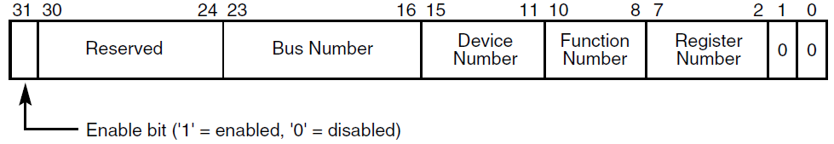
I/O Port CONFIG_ADDRESS (CF8h)
B
D
F
Offset
32 bits (GIMME BUS 0, DEVICE 31 (0x1F), Function 0, offset 0x88)
Port CF8h
Bit 31 when set, all reads and writes to CONFIG_DATA are PCI Configuration transactions
Bits 30:24 are read-only and must return 0 when read
Bits 23:16 select a specific Bus in the system (up to 256 buses)
Bits 15:11 specify a Device on the given Bus (up to 32 devices)
Bits 10:8 Specify the function of a device (up to 8 devices)
Bits 7:0 Select an offset within the Configuration Space (256 bytes max, DWORD-aligned as bits 1:0 are hard-coded 0)
Addresses are often given in B/D/F, Offset notation (also written as B:D:F, Offset)
Notes:
Bits 1:0 ensure 4-byte aligned addresses

Slide 16
I/O Port CONFIG_ADDRESS (CF8h)
B
D
F
Offset
THIS IS KEY!
YOU MUST UNDERSTAND THIS!
Notes:
Bits 1:0 ensure 4-byte aligned addresses

Slide 17
Compatible PCI Configuration Registers
00h
256 bytes
Every PCI device implements this space
PCI Express further extends this to 4KB, we’ll cover that in a bit
First 0x40 bytes are the header
The remaining bytes consist of a device dependent region, which consists of device-specific information per PCI SIG documentation
PCI Configuration Registers Header
3Fh
Device Dependent Region
Last byte = FFh
Notes:
If B0:D0:F0 Header type & 0x80 then it’s a multi-controller device
F0 will control Bus 0
F1 will control bus 1 and so forth

Slide 18
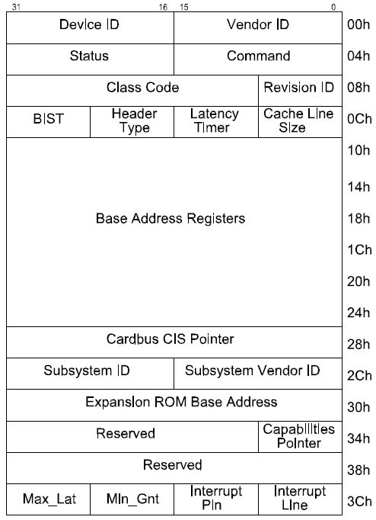
PCI Configuration Registers Header
This is what you should visualize when we're talking about access to specific “register number”/”offsets in CONFIG_ADDRESS
Type 0 header, General PCI Device, PCI Spec 2.3
Notes:
If B0:D0:F0 Header type & 0x80 then it’s a multi-controller device
F0 will control Bus 0
F1 will control bus 1 and so forth

Slide 19
I/O Port CONFIG_DATA (CFCh)
CONFIG_DATA can be accessed in DWORD, WORD, or BYTE configurations
Reads and Writes to CONFIG_DATA with Bit 31 in CONFIG_ADDRESS set/enabled results in a PCI Configuration transaction to the device specified in CONFIG_ADDRESS
PCI spec says that if Bit 31 is not enabled, then the transaction is forwarded out as Port I/O
Notes:
ASDF

Slide 20
Compatible PCI Configuration Space
00h
Implemented in PCIe too
PCI Configuration register
256 bytes
Every PCI device implements this space
PCI Express further extends this to 4KB, we’ll cover that in a bit
First 0x40 bytes are the header
The remaining bytes consist of a device dependent region, which consists of device-specific information per PCI SIG documentation
PCI Configuration Register Header
3Fh
Device Dependent Region
Last byte = FFh
Notes:
If B0:D0:F0 Header type & 0x80 then it’s a multi-controller device
F0 will control Bus 0
F1 will control bus 1 and so forth
??

Slide 21

Compatible PCI Configuration Space
00h
“Enhance header! Rotate 0 degrees!”
PCI Configuration Register Header
3Fh
Device Dependent Region
Last byte = FFh
Notes:
If B0:D0:F0 Header type & 0x80 then it’s a multi-controller device
F0 will control Bus 0
F1 will control bus 1 and so forth
??

Slide 22
Compatible PCI Configuration Space Header (aka "configuration space all up in your face!")
Implemented in PCIe too
Three header types (0-2)
Type 0 = General Device (this is what we care about)
Type 1 = PCI-to-PCI Bridge (rarely care)
Type 2 = CardBus Bridge (don’t care)
Shown is Type 0
Divided into 2 parts:
First 16 bytes (0-F) are standard and defined the same for all devices
The remaining header bytes are optional per the vendor, depending on what function the device performs
Type 0 header, General PCI Device, PCI Spec 2.3
Notes:
If B0:D0:F0 Header type & 0x80 then it’s a multi-controller device
F0 will control Bus 0
F1 will control bus 1 and so forth

Slide 23
PCI Device Identification
Five fields (all required) can be used to identify the device and its basic functionality
Vendor ID identifies the manufacturer of the device
Allocated by the PCI SIG to ensure each is unique
Device ID identifies the particular device, set by the vendor
Revision ID is set by the vendor, viewed as an extension to Device ID (Intel is 8086h, AMD microcontrollers is 1022h)
Class Code used to identify the generic functionality of the device
Header Type identifies what type of header to expect (per the previous slide, general, PCI bridge, CardBus bridge)
Bit 7 being set (0x80) indicates device is a multi-function device
Type 0 header, PCI Spec 2.3
Notes:
If B0:D0:F0 Header type & 0x80 then it’s a multi-controller device
F0 will control Bus 0
F1 will control bus 1 and so forth

Slide 24
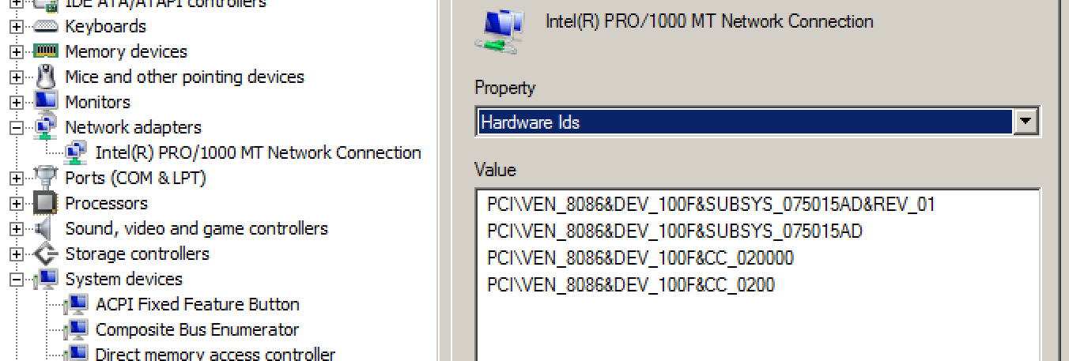
Aside: PCI Vendor/Device IDs
You can see them even on a Windows machine that doesn’t have RWE
Right click on Computer, select Manage
Go to Device Manager (or just enter “Device Manager” from start menu)
Right click on the device and select properties
Go to “Details” tab and select “Hardware Ids”

Slide 25
Base Address Registers (BARs)
Base Address Registers point to the location in the system address space where the PCI device will be located
The device RAM, etc. (anything really, per the vendor)
BARs are R/W and the BIOS programs them to set up the Memory Map
PCI Configuration Registers provides space for up to 6 BARs (bytes 10h thru 27h)
BAR[0-5]
Each BAR is 32-bits wide to support 32-bit address space locations
Concatenating two 32-bit BARs provides 64-bit addressing capability
Type 0 header
Notes:
If B0:D0:F0 Header type & 0x80 then it’s a multi-controller device
F0 will control Bus 0
F1 will control bus 1 and so forth

Slide 26
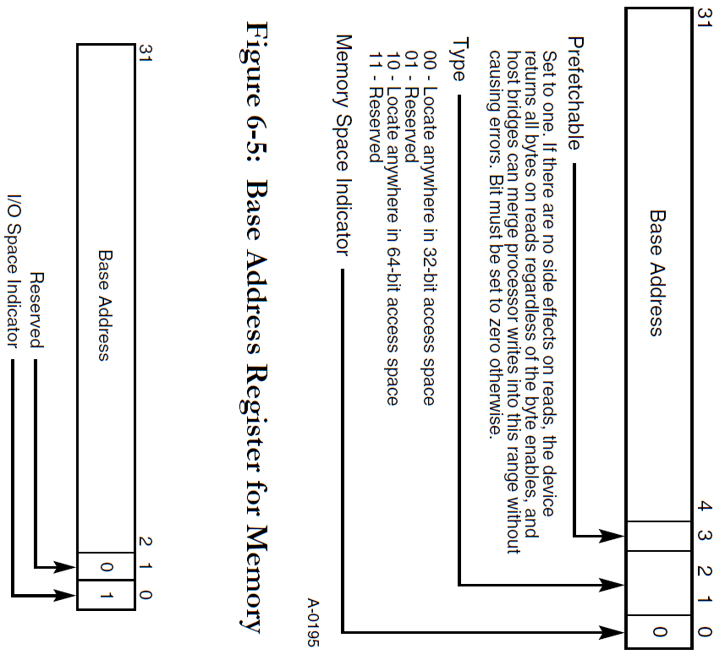
Base Address Register for Memory Space
Actual Base address is obtained by bitwise ANDing the value in bits 31:4 with FFFF_FFF0h (mask the low 4 bits)
Actual Base Address = (BAR[x] & FFFF_FFF0h)
A cleared Bit 0 indicates this will be located in memory address space, otherwise IO space
64-bit accessibility is provided by programming back-to-back BARs
(BAR[x] & FFFF_FFF0h) : (BAR[x+1] & FFFF_FFF0h)*
Meaning BAR[x] is the upper 32 bits, BAR[x+1] is the lower 32 bits
*OSDEV: http://wiki.osdev.org/PCI
Notes:
FIXME: need to double check the math on 64 bit BAR. I suspect it’s wrong/backwards or could be written more properly

Slide 27
Base Address Register for I/O Space
Actual Base address is obtained by logically ANDing the value in bits 31:4 with FFFF_FFF0h (mask the low 4 bits)
Actual Base Address = (Base Address[31:2] & FFFF_FFFCh)
If Bit 0 is 1, then the Base Address will be an offset in the port I/O address space
PCI SIG recommends that devices are mapped to memory rather than I/O, because I/O can be fragmented
Look at the Fixed and Relocatable I/O ports in your friendly neighborhood ICH (or PCH) datasheet

Slide 28
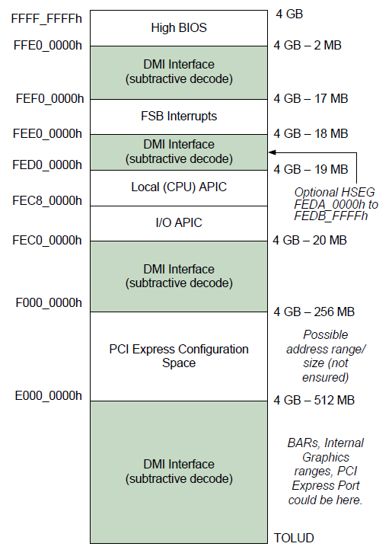
BAR Limit/Size
A Base Address is half the information that’s needed
We need a limit to determine how this PCI device will be mapped into memory
How does the BIOS determine how much space the device needs?
?
Base Address = (E000_0000h & FFFF_FFF0h)

Slide 29
BAR Space Utilization (Size)
1111 1111 1111 1111 1111 1111 1111 1111
FFFF_FFFFh
Example
return
1111 1111 1111 0000 0000 0000 0000 0000
FFF0_0000h
CPU/BIOS can write all 1’s to the BAR to determine how much address space the device needs by writing all 1’s to the BAR
Pro tip: save the original value first! ;)
Device will return 0’s in all "I don’t care if they're set" bits
Or put another way, returns 1s in all the "don't set" bits
The device returns the don’t care bits into the BAR thus telling you how much address space the device needs
Notes:
How might it know that writing 1s is meant to check size? Maybe because if you write a 1 into bit 0, then bit 1 is reserved to 0, and thus writing a 1 into that reserved bit means its size checking time. Maybe test with a less-than-all-1s example

Slide 30
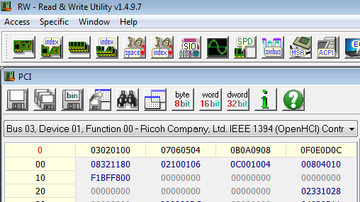
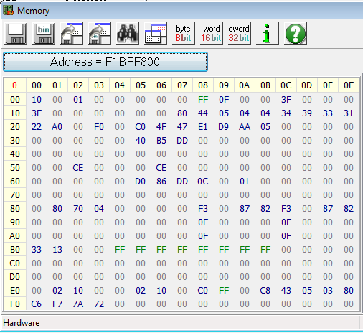
Ex 1: Determine Device Address Space Size
The IEEE 1394 FireWire device on the E6400 has a BAR located at F1BFF800h
Bit 0 = 0, so it’s mapped to memory
Bits 2:1 = 00 so it’s 32-bit address space (below 4GB)
Bit 4 = 0, so it’s not prefetchable
We can open up a memory window at F1BFF800h and see the device

Slide 31
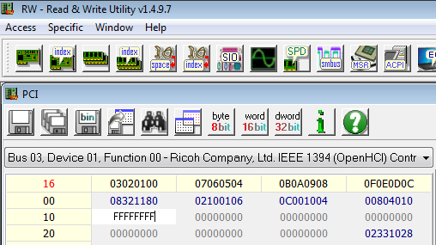
Ex 1: Determine Device Address Space Size
We write all 1’s to it just like the BIOS does to determine the size of the FireWire device
When you try this for yourself, try to pick a device that you know is not actively being used. ;)
These things tend to not fail gracefully in my experience
But it’s nothing a reboot shouldn’t fix (but still, you have been warned, there is no guarantee the vendor has protected itself adequately from erroneous writes)
Check the devices datasheet you might find something interesting

Slide 32
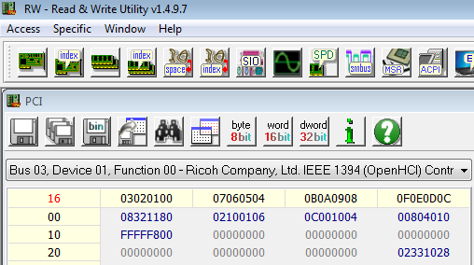
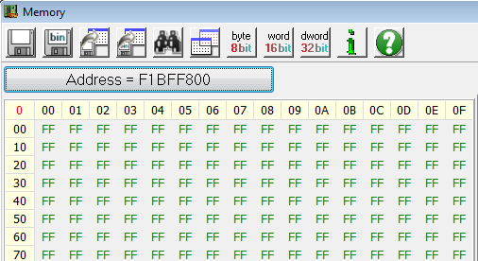
Ex 1: Determine Device Address Space Size
The device returns the value FFFF_F800h to the BAR
These are the don’t care bits which tell us the range of the device memory
~(FFFF_F800) = 7FFh, so the device’s mapped address range in memory is F1BF_F800h - (F1BF_F800 + 7FFh)
Also notice that when we change the value in the BAR, the device is no longer mapped to F1BF_F800h (as evident by all 0xFF’s)

Slide 33
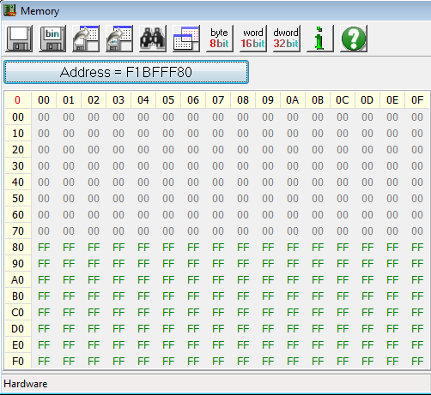
Ex 1: Determine Device Address Space Size
So let’s verify our mapped range:
We’ll view memory address F1BF_FF80h which is 80h bytes before our upper limit address as denoted by the red line

Slide 34
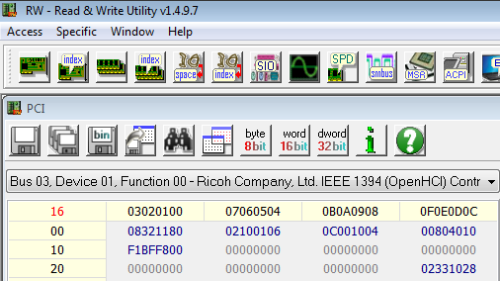
Ex 1: Determine Device Address Space Size
When we reset the BAR back to its original value (F1BF_F800h), the device is (re)mapped back to memory
And it shows our upper limit measurement was correct
It’s good to see for yourself how this world works

Slide 35
Ex 2: Relocate the PCI Device Mapping
So as you noticed, when we changed the value in the BAR, the device was no longer mapped to memory
We wrote a value of all 1’s to it which is an invalid base address in itself (but is designed to return the mask)
So what if we write a valid* address for the device to be mapped to?
*Overlapping ranges are not checked for, “valid” means proceed at your own risk

Slide 36

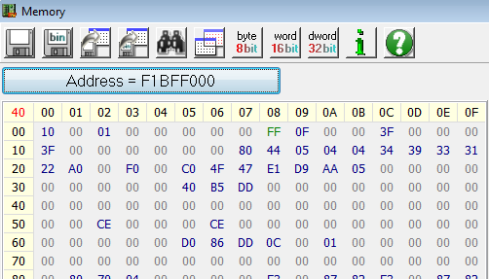
Ex 2: Relocate the PCI Device Mapping
Let’s try moving this to F1BF_F000h
On the E6400 I checked beforehand and saw that this address space appeared to be unused (was all 0xFF’s)
When we write F1BF_F000h to the BAR… the device has been relocated.
This is part of the way the CPU/BIOS builds the memory map
And you can too, with sufficient permissions
Not really a security issue, just a “how the world works” kind of example

Slide 37
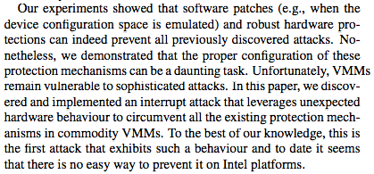
Aside: Things to be aware of once you start learning down at this level
Here's a recent ASIA CCS paper evaluating whether past work on attacks that manipulate PCI (e.g. forcing MMIO overlap, configuration range overlap, etc) and other low level information for a pass-through device inside virtual environments (answer: doesn't seem like it, but they found a new attack :))
On the Feasibility of Software Attacks on Commodity Virtual Machine Monitors via Direct Device Assignment – Pek et al.
https://www.iseclab.org/people/andrew/download/asia14.pdf

Slide 38
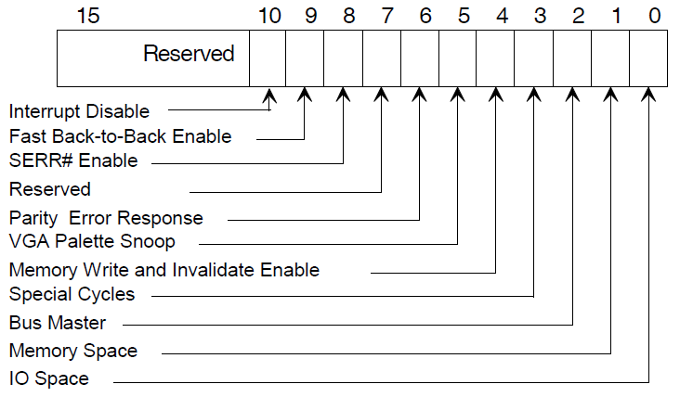
Command Register and Address Space Access
Determine whether a PCI device will respond to I/O accesses and Memory-Space accesses
The BIOS must set the applicable bit(s) to 1 if the device will be mapped to memory and/or I/O space
Turning these off/on will un/map the device (BARs) in the address space
Notes:
Basically think of it as the PCI device has some default state, e.g. telling you whether it is 32 or 64 bit, whether it is prefetchable, whether it wants to map something into memory or IO, etc. The BIOS then comes along and saves this information, queries the mapping size by doing the write-1s, and then maps it wherever it wants to, and sets the appropriate command bits

Slide 39
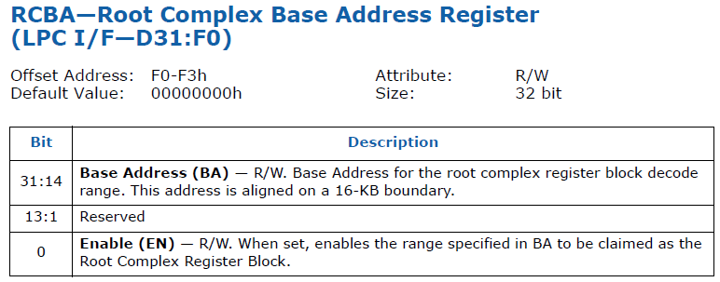
Lab: Use RWE to gather info stored in the PCI configuration space RTFM notes:
“Device 31, Function 0”
If the bus isn't specified by the Intel data sheet you can safely assume it's bus 0
Offset 0xF0 (and it’s 4 bytes big)
So now you have Bus/Device/Function/Offset = 0:1F:0:F0 (31 decimal = 0x1F), and can encode that into the CONFIG_ADDRESS register

Slide 40

Lab: Use RWE to gather info stored in the PCI configuration space
This association is highly refreshing!
Let’s find the RCRB address, since we’ll be using it to get to the SPI flash interface
Refer to your datasheet if doing on your own system but it should be at B0:D31:F0 (LPC device), offset F0h
Notes:
"RCBA = mirror universe spock, because it's the mirror of the ABCs. RCRB = RC Cola…because I wanted one of them to be RC Cola."
Key thing to remember: "RCBA holds RCRB"
http://img1.wikia.nocookie.net/__cb20090608054928/memory-gamma/images/a/a7/Spock_(mirror).jpg
http://ecx.images-amazon.com/images/I/41SH8i1ZunL.jpg
http://2.bp.blogspot.com/-78xSvq-r1ec/UPLWVmmR8kI/AAAAAAAABcw/Icea0Nvo_HQ/s1600/Spock+Goatee.tiff

Slide 41
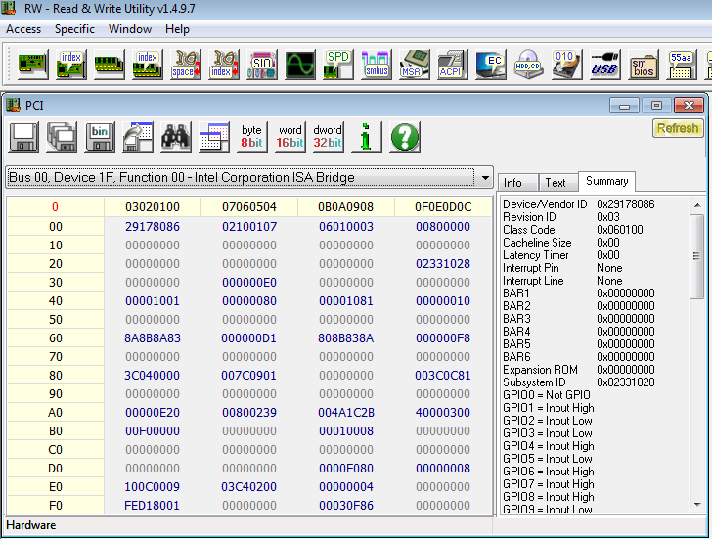

Find Root Complex Register Block (method 1)
RCBA register holds RCRB address
It serves as a base address for memory mapped BARs such as the MCHBAR and SPIBAR (will be identified/explained as they come)
On the example Dell E6400 with 4GB RAM, RCRB was at FED1_8000h

Slide 42
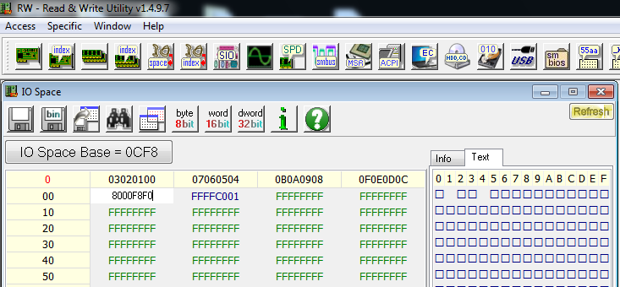
Find Root Complex Register Block (method 2)
CFCh
CF8h and CFCh are adjacent DWORDs
LPC (B0:F31:D0, offset F0h) is 8000F8F0
So enter 8000F8F0 into port CF8h

Slide 43
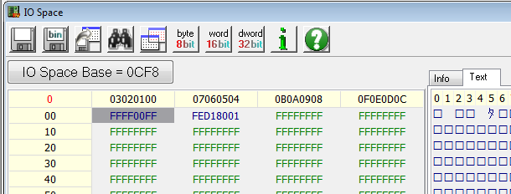
Find Root Complex Register Block (method 2, cont)
CFCh
So we have now determined that the RCRB address is FED1_8000h
Bit 0 is just an enable bit, still a 32-bit physical address
Aside, the dword at CF8h resets itself. If you keep this IO window open you might see PCI port IO accesses (if there are processes running that perform this)
I have seen this occur on Windows 8 where the vendor/device ID of one of the PCI devices on the CPU is read every few seconds or so; I have not determined which process(es) are doing this
Notes:
"And so when you put RCRB into CF8, out 'pops' (hyuk hyuk) RCBA!"
(it's a joke because in the US midwest we call soda pop just "pop")

Slide 44
PCI vs. PCIe config space access

Slide 45
Compatible PCI Configuration Registers
00h
This is your brain on PCI
PCI Configuration Registers Header
3Fh
Device Dependent Region
Last byte = FFh
Notes:
If B0:D0:F0 Header type & 0x80 then it’s a multi-controller device
F0 will control Bus 0
F1 will control bus 1 and so forth

Slide 46
PCIe Configuration Space
00h
This is your brain on PCIe
(hint: the scale just shifted)
PCI Configuration Register Header
3Fh
Device Dependent Region
FCh
PCIe Extended Config Space
Device Dependent Region
Last byte = FFFh
Notes:
If B0:D0:F0 Header type & 0x80 then it’s a multi-controller device
F0 will control Bus 0
F1 will control bus 1 and so forth
??

Slide 47
PCIe Extended Config Space Access
The BIOS needs to set the PCIEXBAR register to the location that it wants the memory controller to start routing to PCI space

Slide 48
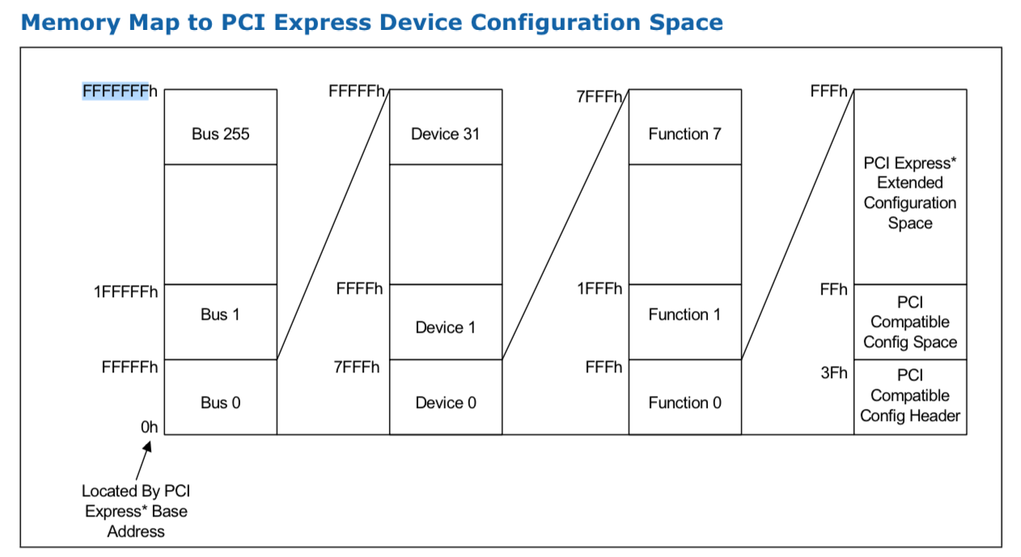
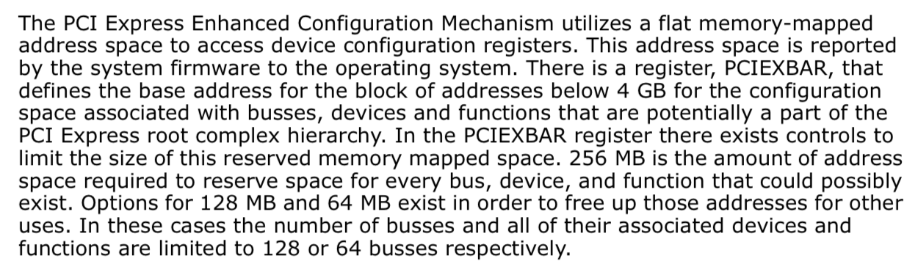
From 3-series-express-chipset-family-datasheet.pdf

Slide 49
PCIe Memory-Mapped Config Space Access
PCIe memory-mapped decoding:
35
28
27
20
19
15
14
12
11
0
PCIEXBAR’s Bits 35:28 | Bus (8 bits) | Device (5 bits | Function (3 bits) | Offset (12 bits)
Compare to PCI IO-mapped decoding:

Slide 50
Optional TODO
Change the slides after this to search for BIOS_CNTL instead of PCIEXBAR

Slide 51
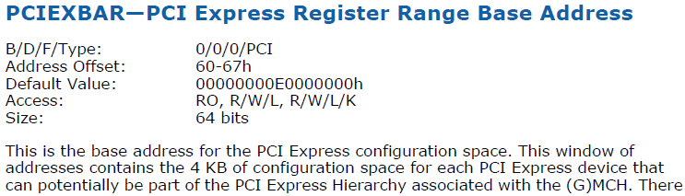
BIOS Analysis: Finding where the BIOS does PCI stuff
Scenario: Let’s say we want to locate where in the executable BIOS the system programs the PCIEXBAR
Looking in our datasheet, we see that, on our sample system, it is located in the DRAM Controller, which is located at B0:D0:F0. The specific 64 bit register is then at offset 60-67h
So we know I/O accesses to this will be to 0x80000060
Remember, accesses to CONFIG_ADDRESS are always 4-byte aligned
It’s not elegant, but it is scriptable
Notes:
This is my least favorite way of finding where things are configured, but it *can* work

Slide 52
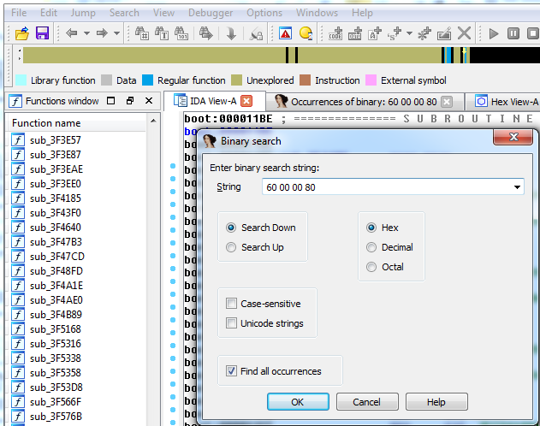
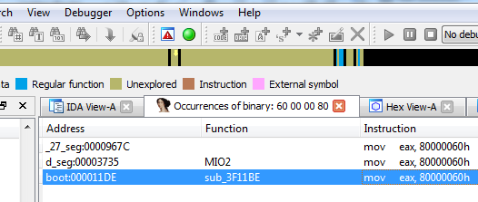
BIOS Analysis: Finding PCI Configuration
So with 80000060h in mind, let’s look at our BIOS binary which we dumped using Copernicus
Looking in IDA Pro (Free version works fine), we can go to Search -> sequence of bytes, and enter: 60 00 00 80
Little endian byte order
Simplistic, perhaps even lame, yet yields useful results:
Notes:
We’ve either already mentioned these tools or will talk about them in more detail.

Slide 53
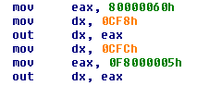
BIOS Analysis: Interpreting PCI Configuration
FC00_0000h
PCI Express
configuration space
F800_0000h
For example the following disassembly snapshot maps the PCI Express registers to memory address F800_0000h
Per the PCIEXBAR register definition in the datasheet, it also allocates 64MB of space for it in the memory map (bits 2:1) and then activates it (bit 0)
So interestingly not all devices/functions may be mapped to memory
System configuration is very concise!
Notes:
Look at all that is done in just a few instructions. BIOS is very concise code indeed

Slide 54
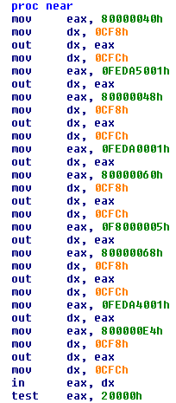
Back to that Memory Map…
Looking for 80000060h led us to a big ol’ block of memory map configuration code
I’ll leave it up to you to verify, but this block (in order):
Sets the Egress Port Base Address to FEDA_5000h and enables it
Sets the MCH Memory Mapped Register Range Base to FEDA_0000h and enables it
Allocates 64MB of memory for PCIEXBAR at base address F800_0000h
Sets DMIBAR to FEDA_4000h and enables it
And lastly it’s testing bit 49 (not a typo) in the Capabilities register to check whether the MCH is capable of supporting DDR SDRAM
You will find a lot more in the BIOS, but this is how its done
Notes:
Some things are easier to look at in text mode than graph mode (in my opinion) and this is one of them.
So this sets up a whole bunch of that memory map, which pretty much brings us full circle.
Some of these you’ll really have to look up for yourself. DMIBAR, etc.

